Slide 1


Intro to Statistical Modeling

Slide 2
Motivations

Slide 3
Motivations
The intention of this lecture is not to explain the details of Statistical Model.
Rather it is an overview of what can be accomplished with Statistical Model.
If it inspires you, then you’ll have to take the course and learn a lot of cool stuff !

Slide 4
Contents

Slide 5
Contents:
Controlled Experiment
Case: Polio in U.S
Control vs Treatment
Bias in Sampling
Randomization
Observational Experiment
Bias: Confounding
Data Generation Process
Statistical Model
Real World vs Model
Machine Learning vs Statistics
Inferences

Slide 6
Controlled Experiment

Slide 7
Controlled Experiment
Hi there Statisticians!

Slide 8
Controlled Experiment
We have some problems for you:

Slide 9
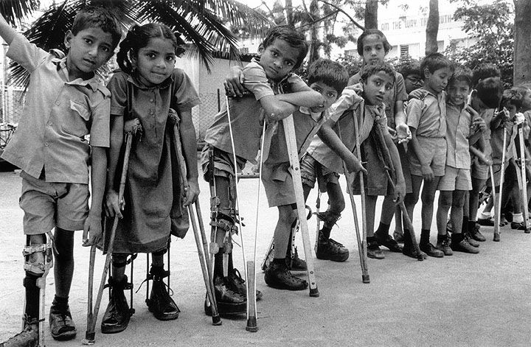
Controlled Experiment
Poliovirus causes muscle weakness:

Slide 10
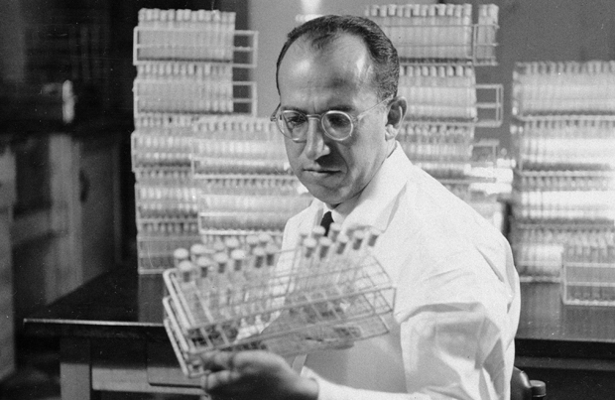
Controlled Experiment
dr. Salk might have the cure. Does he?

Slide 11
Controlled Experiment
Could Salk’s new medical treatment cures polio?

Slide 12
Controlled Experiment
Dear Statisticians, can you help build a model to prove the effect of Salk’s new treatment?

Slide 13
Controlled Experiment
In 1953 there was 30.000 polio cases.

Slide 14
Controlled Experiment:
Design Experiment
The idea:
Population
Treatment
Vaccine

Slide 15
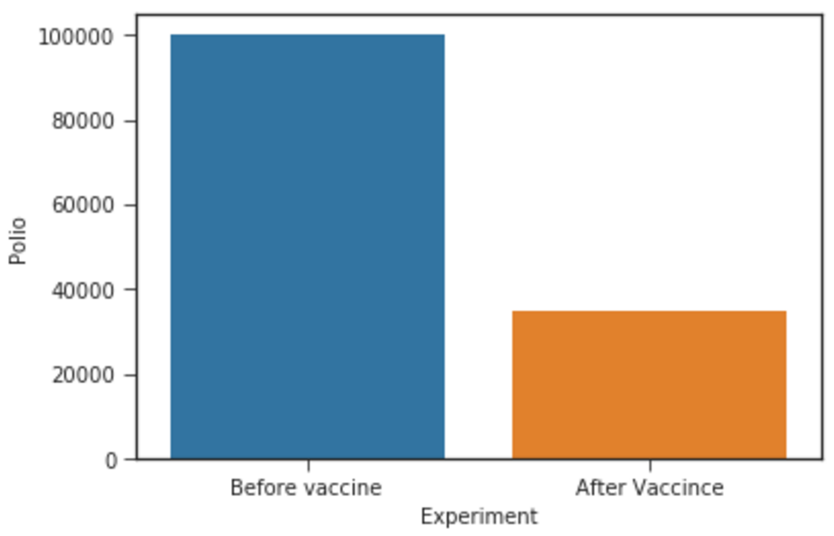
Controlled Experiment
If we give vaccines, the polio cases should decrease

Slide 16
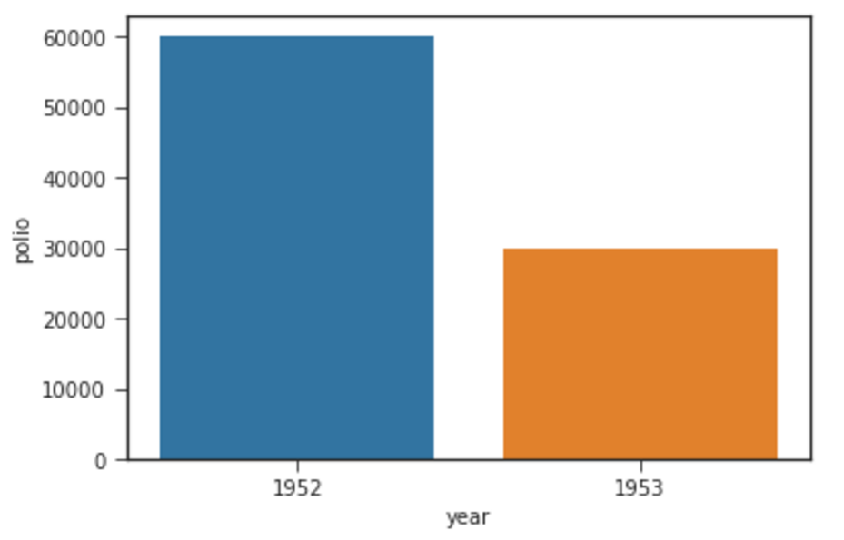
Controlled Experiment
Problem: there is a variance in polio cases per year

Slide 17
Controlled Experiment
There is a variance in polio cases per year
There might be other factors which might cause decreasing of polio cases, say X.
If we give the polio vaccine to the population, it might cause decreasing of polio cases, say V.

Slide 18
Controlled Experiment
Problem: we cannot differentiate the effect of X and V on polio cases
Population
Vaccine

Slide 19
Controlled Experiment
Take home messages:
In controlled experiment we want to see the effect of treatment.
We cannot see the effect of treatment if we gave it all to the population.

Slide 20
Controlled Experiment
Is there a solution?

Slide 21
Controlled Experiment:
Control vs Treatment

Slide 22
Controlled Experiment:
Control vs Treatment
Population
Treatment
Vaccine

Slide 23
Controlled Experiment:
Control vs Treatment
Is there a better way to measure the effect of treatment?

Slide 24
Controlled Experiment:
Control vs Treatment
From population, we get some samples:
Population
Sample

Slide 25
Controlled Experiment:
Control vs Treatment
Sample A
Population
Sample
We separate these samples into two set
Sample B

Slide 26
Controlled Experiment:
Control vs Treatment
Sample A
Sample B

Slide 27
Controlled Experiment:
Control vs Treatment
Sample A
Treatment
Sample B
Vaccine

Slide 28
Controlled Experiment:
Control vs Treatment
Control Group
Rename the sample
Treatment
Treatment Group
Vaccine

Slide 29
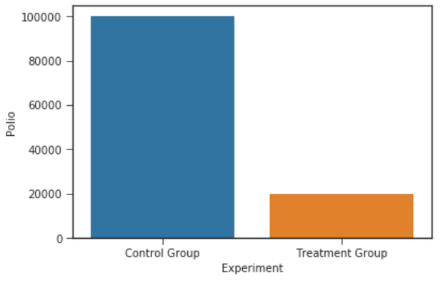
Controlled Experiment:
Control vs Treatment
Control Group
If the treatment works, then the polio cases in treatment group should be smaller compare to control group
The result should be:
Treatment Group

Slide 30
Controlled Experiment:
Control vs Treatment
Take home message:
Controlled vs Treatment Experiment is a good idea to separating treatment effect and others effects.

Slide 31
Controlled Experiment:
Control vs Treatment
Statisticians:
“Let’s do a Controlled Experiment Research on Salk’s vaccine effect.”

Slide 32
Controlled Experiment:
Sampling Bias

Slide 33
Controlled Experiment:
Control vs Treatment
Control Group
Treatment Group

Slide 34
Controlled Experiment:
Control vs Treatment
Control Group
Treatment Group
High income family

Slide 35
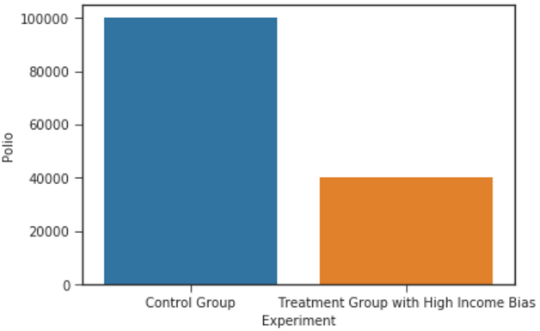
Controlled Experiment:
Control vs Treatment
The result with High Income bias:

Slide 36
Controlled Experiment:
Control vs Treatment
The result with High Income bias:
The result with without bias:

Slide 37
Controlled Experiment:
Control vs Treatment
Control Group
Treatment Group
Higher Risk to Polio
Hygiene
High income family

Slide 38
Controlled Experiment:
Control vs Treatment
Take home messages:
Although you split the sample data into control group and treatment group, your method still can be biased.
The result with High Income bias:
The result with without bias:

Slide 39
Controlled Experiment:
Control vs Treatment
Is there a solution?

Slide 40
Controlled Experiment:
Randomization

Slide 41
Controlled Experiment:
Randomization
Take home messages:
Although you split the sample data into control group and treatment group, your method still can be biased.
The result with High Income bias:
The result with without bias:

Slide 42
Controlled Experiment:
Randomization
“The treatment had to be chosen from the same population as control group” -- Freedman

Slide 43
Controlled Experiment:
Randomization
Treatment
Population
Control

Slide 44
Controlled Experiment:
Randomization
Treatment
Population
Randomization
Control

Slide 45
Controlled Experiment:
Randomization
Treatment
Treatment
Vaccine
Population
Randomization
Control

Slide 46
Controlled Experiment:
Randomization
Double Blind
Treatment
Population
Vaccine
Randomization
Randomization
Placebo
Control

Slide 47
Controlled Experiment:
Randomization
What would be the result?

Slide 48
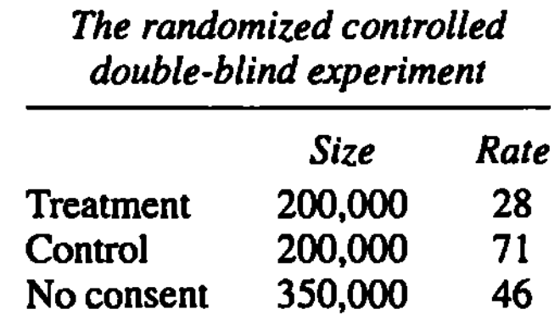
Controlled Experiment:
Randomization
The result of Salk’s vaccine:
Vaccine works!

Slide 49
Controlled Experiment:
Randomization
Take home messages:
Controlled Group and Treatment Group had to come from the same population.
We can do a randomization to get the same population.

Slide 50
Controlled Experiment:
Randomization
Question:
Can we build a Randomized Controlled Experiment for every problem?

Slide 51
Question?

Slide 52
Observational Experiment

Slide 53
Observational Experiment
Question:
Can we build a Randomized Controlled Experiment for every problem?

Slide 54
Observational Experiment
Double Blind
Treatment
Population
Vaccine
Randomization
Randomization
Placebo
Control

Slide 55
Observational Experiment
Research : We want to measure effect of smoking on our health
Problem : No body want to smoke for 10 years just for a research.

Slide 56
Observational Experiment
Research : We want to measure effect of smoking on our health
Problem : No body want to smoke for 10 years just for a research.
What you will get is the data which you cannot be controlled

Slide 57
Observational Experiment:
Confounding Bias

Slide 58
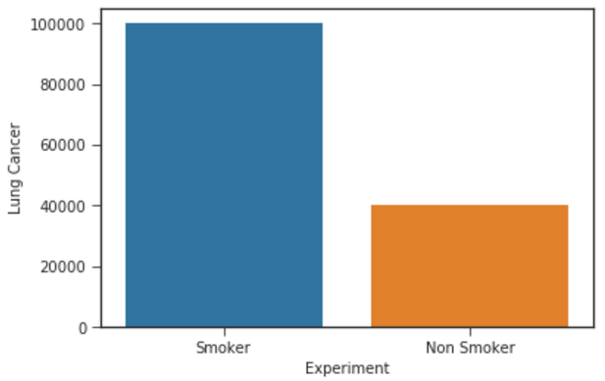
Observational Experiment:
Confounding Bias
Research : We want to measure effect of smoking on our health
Well if you insist, let’s do the research, perhaps we will get a valid conclusion ....

Slide 59
Observational Experiment:
Confounding Bias
Research : We want to measure effect of smoking on our health
Well if you insist, let’s do the research ….
Non Smoker Group
Smoker Group
Male

Slide 60
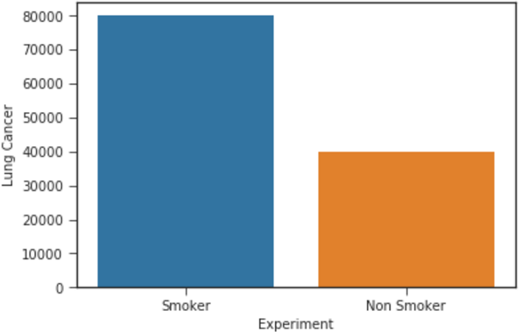
Observational Experiment:
Confounding Bias
Research : We want to measure effect of smoking on our health
Well if you insist, let’s do the research ….
Without male bias

Slide 61
Observational Experiment:
Confounding Bias
Take home messages:
In Observational Experiment we have to minimize the confounding bias

Slide 62
Observational Experiment:
Confounding Bias
Let’s do another observational experiment!

Slide 63
Observational Experiment:
Confounding Bias
Let’s do another observational experiment
Research : There is a gender bias in graduate admissions.

Slide 64
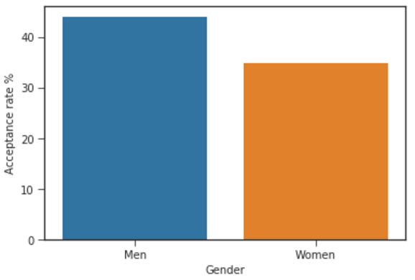
Observational Experiment:
Confounding Bias
Research : There is a gender bias in graduate admissions.

Slide 65
Observational Experiment:
Confounding Bias
Research : There is a gender bias in graduate admissions.
Really? Let’s compare it for every major

Slide 66
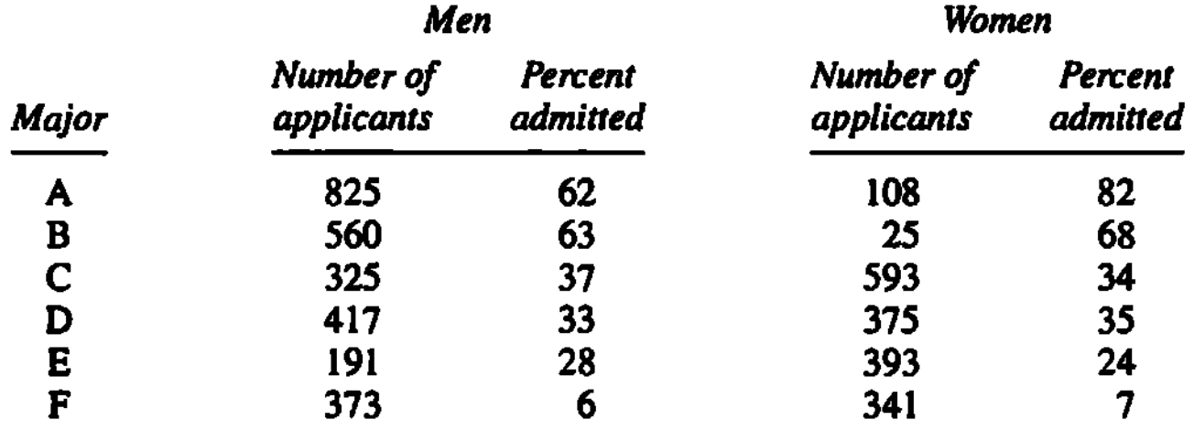
Observational Experiment:
Confounding Bias
Research : There is a gender bias in graduate admissions.

Slide 67
Observational Experiment:
Confounding Bias
Research : There is a gender bias in graduate admissions.
Percent Applied
Percent Applied
30
7
20
2
12
39
15
24
7
19
17
9

Slide 68
Observational Experiment:
Confounding Bias
Research : There is a gender bias in graduate admissions.
High Acceptance Rate Major
Male
Gender Bias
Low Acceptance Rate Major
Female

Slide 69
Observational Experiment:
Confounding Bias
Take home messages:
In Observational Experiment we have to minimize the confounding bias
BUT HOW?

Slide 70
Question?

Slide 71
Observational Experiment:
Data Generating Process

Slide 72
Observational Experiment:
Data Generating Process
Research : There is a gender bias in graduate admissions.
High Acceptance Rate Major
Male
Gender Bias
Low Acceptance Rate Major
Female

Slide 73
Observational Experiment:
Data Generating Process
Control Group
Polio
Treatment Group
Higher Risk to Polio
Hygiene
High income family

Slide 74
Observational Experiment:
Data Generating Process
Research : We want to measure effect of smoking on our health
Well if you insist, let’s do the research ….
Non Smoker Group
Smoker Group
Male

Slide 75
Observational Experiment:
Data Generating Process
Take Home Message
The best way to have a valid conclusion is to understand your research problem and your data
Thus you have to understand Data Generating Process

Slide 76
Observational Experiment:
Data Generating Process
Modeling Philosophy: You have to know the data, how the real world system generate the data, then you can build a “good” model.
Data Generating Process:
How the real world works and generate our data.

Slide 77
Observational Experiment:
Data Generating Process
Research:
Dear Statistician, please strengthen the body part of our aircraft to minimize the probability to crash of our squadron.

Slide 78
Observational Experiment:
Data Generating Process

Slide 79
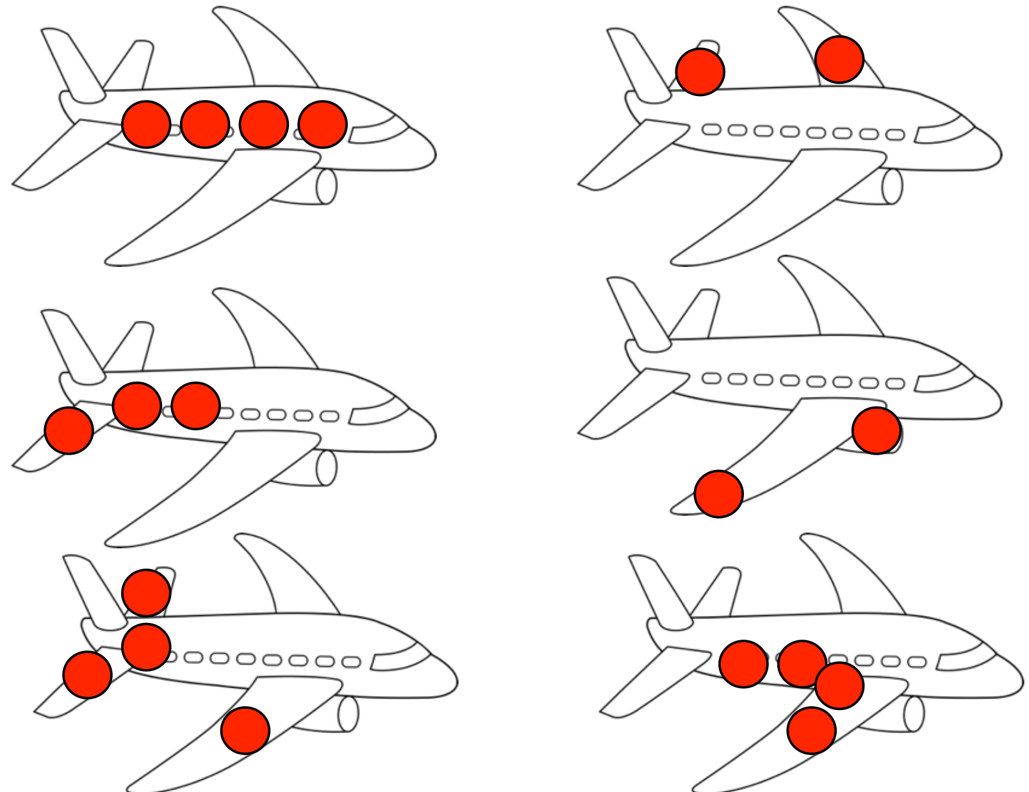
Observational Experiment:
Data Generating Process
Question:
Which part?

Slide 80
Observational Experiment:
Data Generating Process
Question:
Which part?
From 1000 aircrafts on ground after attacking the enemy:
Wing | 200
Engine | 20
Body | 100

Slide 81
Observational Experiment:
Data Generating Process
Question:
Which part? All aircrafts are hitted
Wing
Down
Engine
Hit
Landed Home
Body

Slide 82
Observational Experiment:
Data Generating Process
Question:
Which part? All aircrafts are hitted and equally likely
and independent at every body part
Wing
Down
134
334
Hit
Landed Home
200

Slide 83
Observational Experiment:
Data Generating Process
Question:
Which part? All aircrafts are hitted and equally likely
and independent at every body part
Down
Engine
313
333
Hit
Landed Home
20

Slide 84
Observational Experiment:
Data Generating Process
Question:
Which part? All aircrafts are hitted and equally likely
and independent at every body part
Down
333
Body
233
Hit
Landed Home
100

Slide 85
Observational Experiment:
Data Generating Process
Question:
Which part?
From 1000 aircrafts on ground after attacking the enemy:
Wing | 200
Engine | 20
Body | 100
This is your only observation

Slide 86
Observational Experiment:
Data Generating Process
Take Home Message
The best way to have a valid conclusion is to understand your research problem and your data
Thus you have to understand Data Generating Process
Statistics is not an oracle which always give you the true conclusion.

Slide 87
Statistical Modeling

Slide 88
Statistical Modeling:
Real World

Slide 89
Real World
Real World

Slide 90
Real World
Real World

Slide 91
Real World
Data
Real World

Slide 92
Real World
Data
Model
Real World

Slide 93
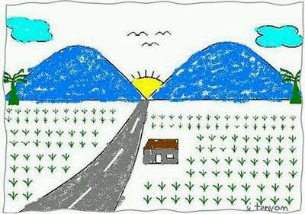
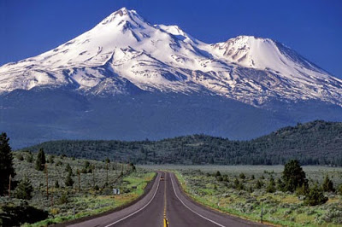
Real World Analogy
Data
Derman (2012)
“ Model is only our oversimplification of real world”

Slide 94
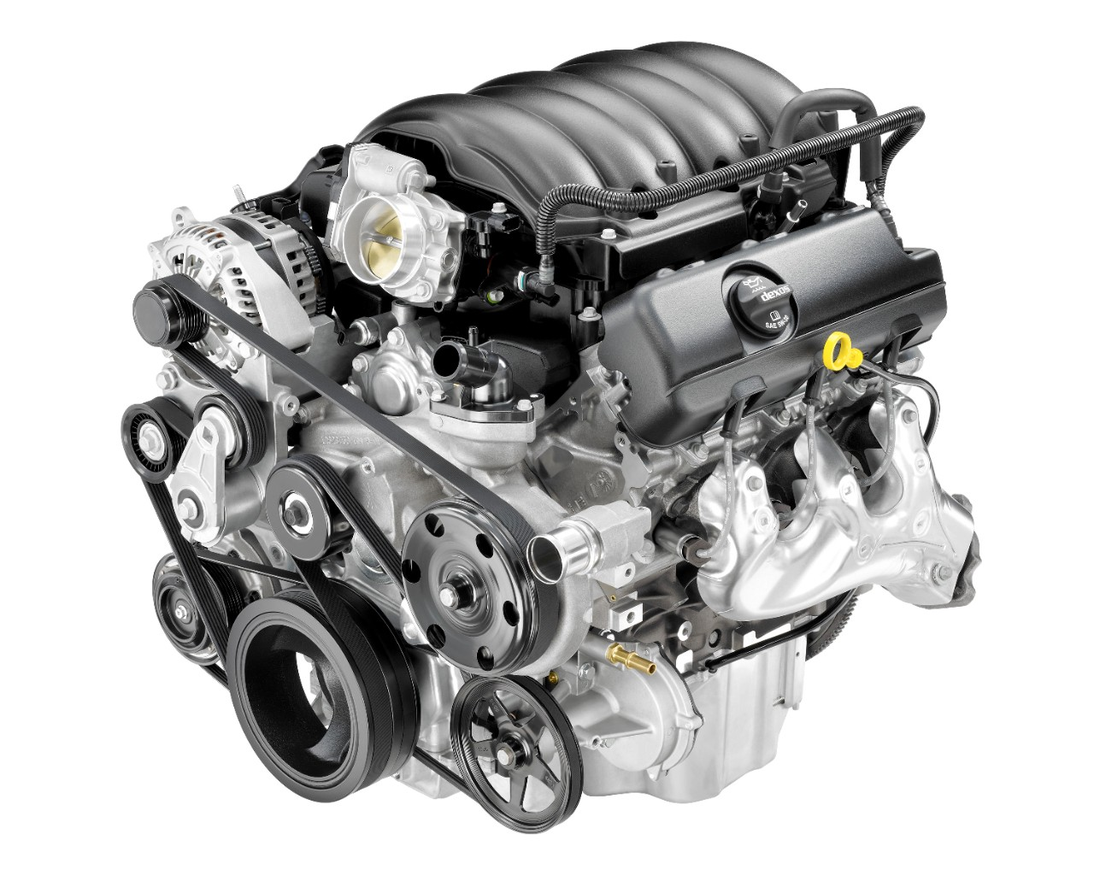
Real World Analogy
Data
Breiman (2001)
Model
Real World
“ Model should explain DIRECTLY or INDIRECTLY how the real world works”

Slide 95
Statistical Modeling:
How the Model Works

Slide 96
Real World
Real World
𝐗

Slide 97
Real World
𝒀
Real World
𝐗

Slide 98
Real World
𝒀
𝐗

Slide 99
Model vs Real World
𝒀
𝐗
“What about model?“

Slide 100
Real World Modeling
Data
Model
Real World

Slide 101
Our Modeling Focus
“ In this class, we will only focus on supervised learning “
(𝑿, 𝒀)

Slide 102
Statistical Modeling:
Statistics vs. Machine Learning

Slide 103
Real World
𝒀
Real World
𝐗

Slide 104
Statistics
𝒀
𝑿

Slide 105
Statistics vs. Real World
𝒀
Real World
𝐗
Breiman (2001)
𝒀
Statistics
𝑿

Slide 106
Statistics vs. Real World
𝒀
Real World
𝐗
Breiman (2001)
𝒀
Linear Reg
Logistic Reg
Cox Model
𝑿

Slide 107
Statistics
“ The goal of Statistics is to DIRECTLY EXPLAIN the Real World. If you can explain the Real World, you can predict the Real World“

Slide 108
What about Machine Learning?
𝒀
Real World
𝐗

Slide 109
Machine Learning
𝒀
Real World
𝐗
Breiman (2001)
Machine Learning

Slide 110
Machine Learning
𝒀
Real World
𝐗
Breiman (2001)
Neural Networks
Support Vector Machine
Gradient Boosting
KNN

Slide 111
Machine Learning vs. Statistics
INFERENCES
Main goal of Statistics
Trying to understand Real World
Fight against Biases and Fallacy
PREDICTION
Main goal of Machine Learning
Trying to approximate function
Optimization in Feature Space

Slide 112
Statistical Modeling:
Inferences

Slide 113
Inferences
Start with a question:
“ Does increase in Income have any effect to Consumption?”

Slide 114
Inferences
Start with a question:
“ Does increase in Income have any effect to Consumption?”
Form a Hypothesis:
H0: There is no effect from increasing of Income to Consumption.
H1: There is an effect.

Slide 115
Inferences
Make a Data Generation Process “Hypothesis”

Slide 116
Inferences
Make a Data Generation Process “Hypothesis”
Income
Consumption

Slide 117
Inferences
Make a Data Generation Process “Hypothesis”
Income
Consumption
Saving

Slide 118
Question?

Slide 119
Class: Silabus

Slide 120
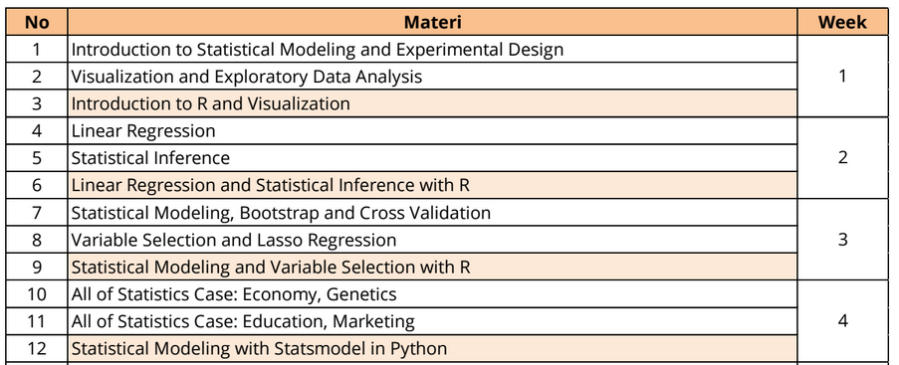
Class: Silabus, R, Tugas

Slide 121
Class: Silabus, R, Tugas

Slide 122

Class: Silabus, R, Tugas

Slide 123
Class: Silabus, R, Tugas
Tugas:
Per minggu, akan kami publish setiap hari senin.
Isi: Coding dan intepretasi dari model
Sertifikat:
Sertifikat berisi nilai tugas dan test. Tugas 65%, Test 35%.
Komunikasi:
Google group: Material
Whatsapp
JANGAN: Hubungi saya chat per orangan. 1 vs 60. :(

Slide 124
Class: Silabus, R, Tugas
Penting:
Kelas ini seperti kelas kuliah, anda tidak bisa duduk saja kemudian berharap bisa mengerti segalanya. Anda harus belajar dari buku atau paper yang kami bagikan.
Tidak ada cara mudah dalam melakukan Statistik. Kami tidak akan menjelaskan cara mudah namun salah kepada anda.

Slide 125
Thank you
Adityo Sanjaya
Haqi Muflih

